Slide 1
Population Formulas

Slide 2
Population Density

Slide 3
Birth Rate (%)

Slide 4
Crude Birth Rate

Slide 5
Death Rate (%)

Slide 6
Crude Death Rate

Slide 7
Population Change

Slide 8
Population Growth Rate

Slide 9
Doubling Time

Slide 10
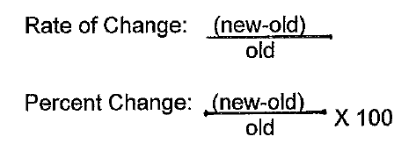
Rate of Change and Percent Change

Slide 11
Natural Rate of Population Increase

