Slide 1
Ecology Notes Part 1
Energy Flow Ecological Pyramids, Productivity

Slide 6
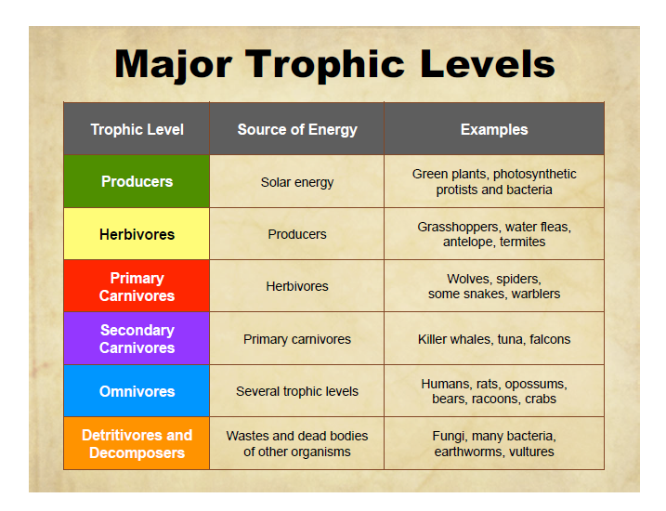

Slide 12
Ecological Pyramids
Pyramids of Energy
Pyramids of Biomass
Pyramids of Numbers

Slide 18
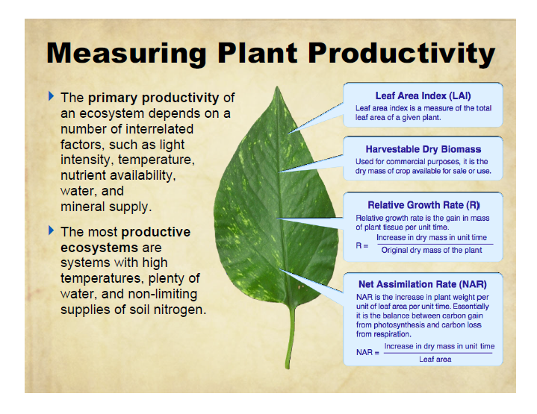

Slide 19
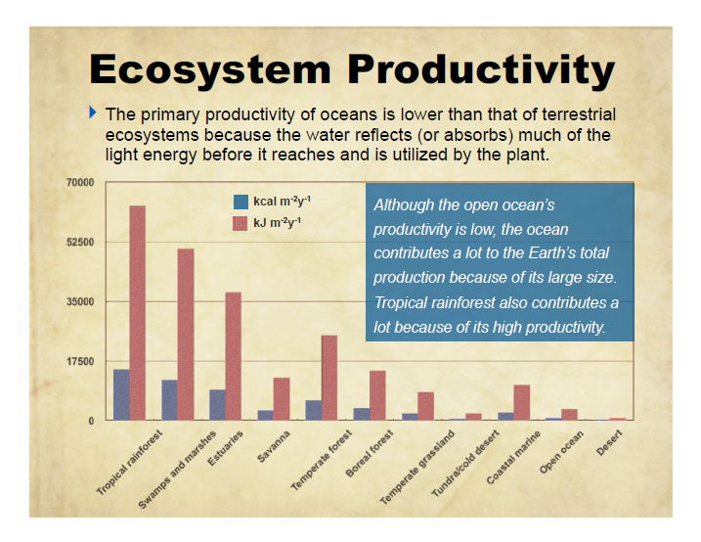

Slide 20
Biological Magnification
The tendency of toxins to become concentrated in higher trophic levels

Slide 21
