Slide 1
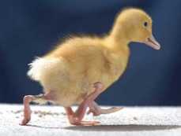
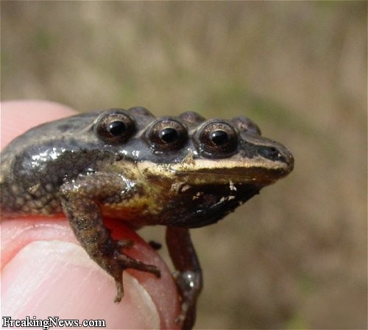

Slide 2
DNA Mutation

Slide 3
I. DNA Replication Review

Slide 4
DNA Replication
I. How DNA Replicates
DNA is a molecule composed of TWO strands, each consisting of a sequence of nucleotides.
The order of the nitrogen bases on one strand mandates the sequence of bases on the complementary strand.

Slide 5
Steps in Replication
Steps In Replication
1) Enzymes break down the hydrogen bonds between the two DNA strands, unzipping the molecule

Slide 6
Steps in Replication
2) As the DNA unzips, free nucleotides (from surroundings in the nucleus) bond to the single strands by base pairing (A-T, G-C)

Slide 7
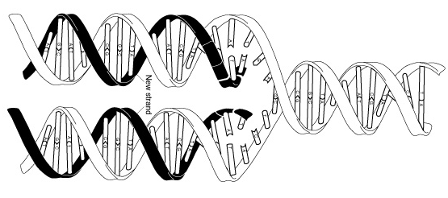
Steps in Replication
3) Another DNA Polymerase Enzyme bonds the new nucleotides into a chain
** The result of this process is the formation of TWO DNA molecules, each identical to the original molecule.

Slide 8
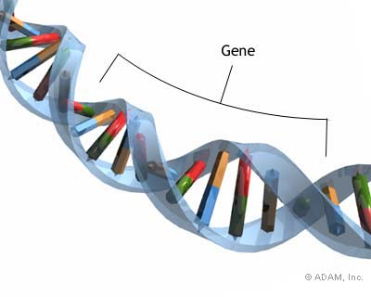
Terms Review
Gene - A segment of DNA that codes for a specific protein
DNA – Long strand of nucleic acids, the master blueprint for all the proteins to be made in the cell. Long strands of DNA are called chromatin.

Slide 9
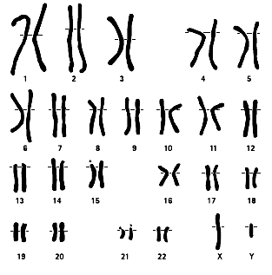
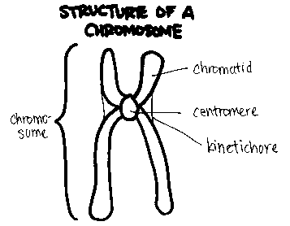
Chromosome – A strand of specific DNA that is coiled, condensed, and located in the nucleus. Humans have 23 pairs of chromosomes, for a total of 46 chromosomes.

Slide 10
II. Mutations
Sometimes cells make mistakes copying their DNA – these mistakes are called mutations.
Mutations are changes in genetic material.
There are two major types of mutation – gene mutations or chromosome mutations.

Slide 11
II. Mutations
D. Mutations that produce a change in a single gene are called gene mutations.
E. Mutations that produce changes in a complete chromosome are called chromosome mutations.

Slide 12
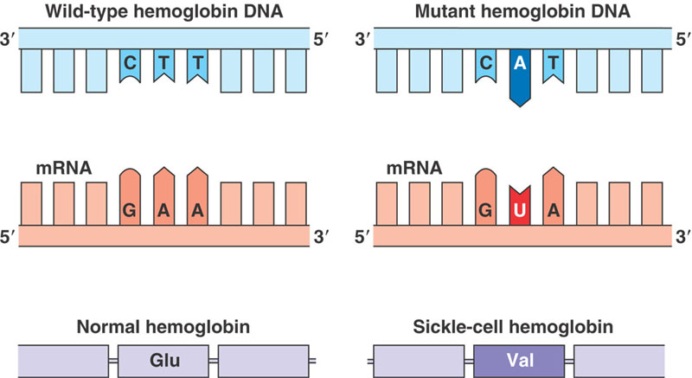
III. Gene Mutations
There are two different types of gene mutations
Point mutations
Frameshift mutations

Slide 13
III. Gene Mutations
B. Point mutations involve change at a single point in the DNA. In a point mutation, there is a substitution of one base for another. Point mutations usually affect only one amino acid.
Example: AGG TCT
Mutation: AGG TAT

Slide 14
III. Gene Mutations
C. Frameshift mutations happen when there is an insertion of an extra base or a deletion of a base. An insertion or deletion changes all the groups of three bases (codons). A frameshift mutation can change every amino acid that follows the point of mutation.

Slide 15
Example: AAC TTC CCT
Now (deletion): AAT TCC CT
Example: AAC TTC CCT
Now (insertion): AAC TTA CCC T

Slide 16
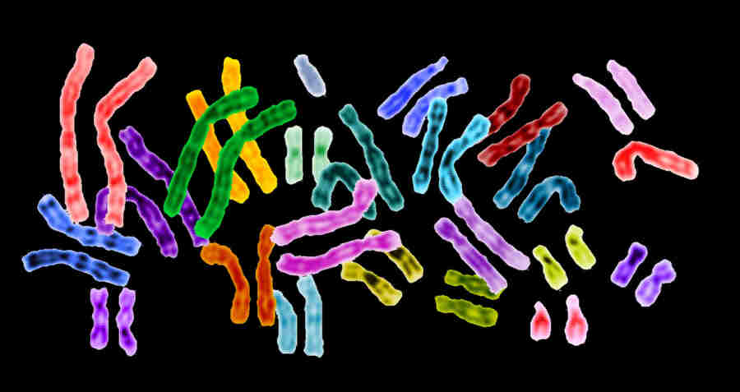
Gene Expression
Each one of your cells contains the exact same copy of DNA.
Why do some cells produce different proteins than others?

Slide 17
Gene Expression
When a particular protein is made, a gene is being expressed.
Gene expressed = gene turned ON
If a gene is not allowed to be expressed, then that protein will not be made.
Gene NOT expressed = gene turned OFF
Gene Regulation is a process where a cell determines which genes it will express and not express.

Slide 18
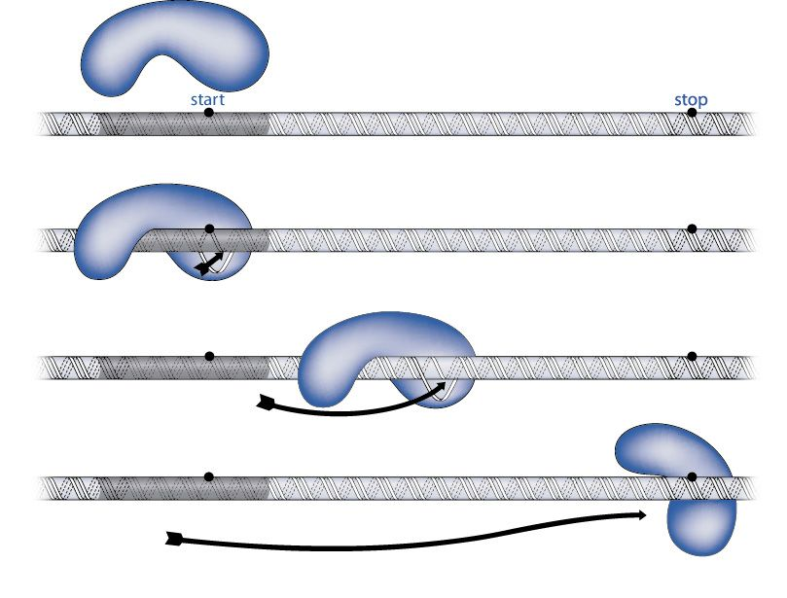
Gene Expression
In order for a gene to be expressed, and enzyme called RNA polymerase must be able to bind to the DNA strand it is trying to copy.

Slide 19
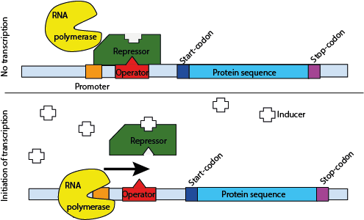
Gene Expression
RNA Polymerase can be blocked by a repressor, which will not allow it to read and copy the DNA.
When RNA Polymerase is blocked by the repressor, the gene will not be expressed.

Slide 20
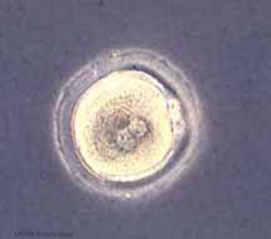
Cell Differentiation
You came from just one cell!

Slide 21
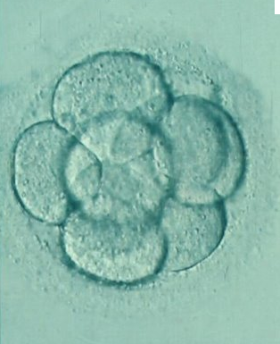
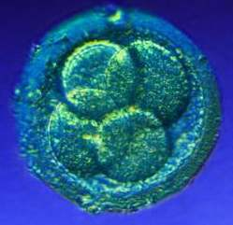
Cell Differentiation
That one cell divided in to two cells. Those cells divided, and those cells divided…

Slide 22
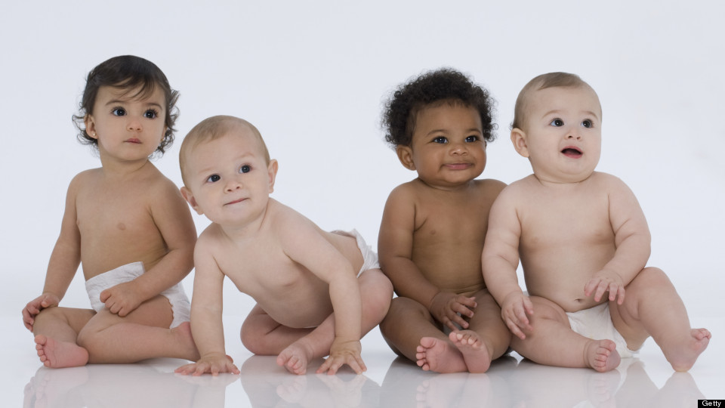
Cell Differentiation
So how did that ball of cells become you?

Slide 23
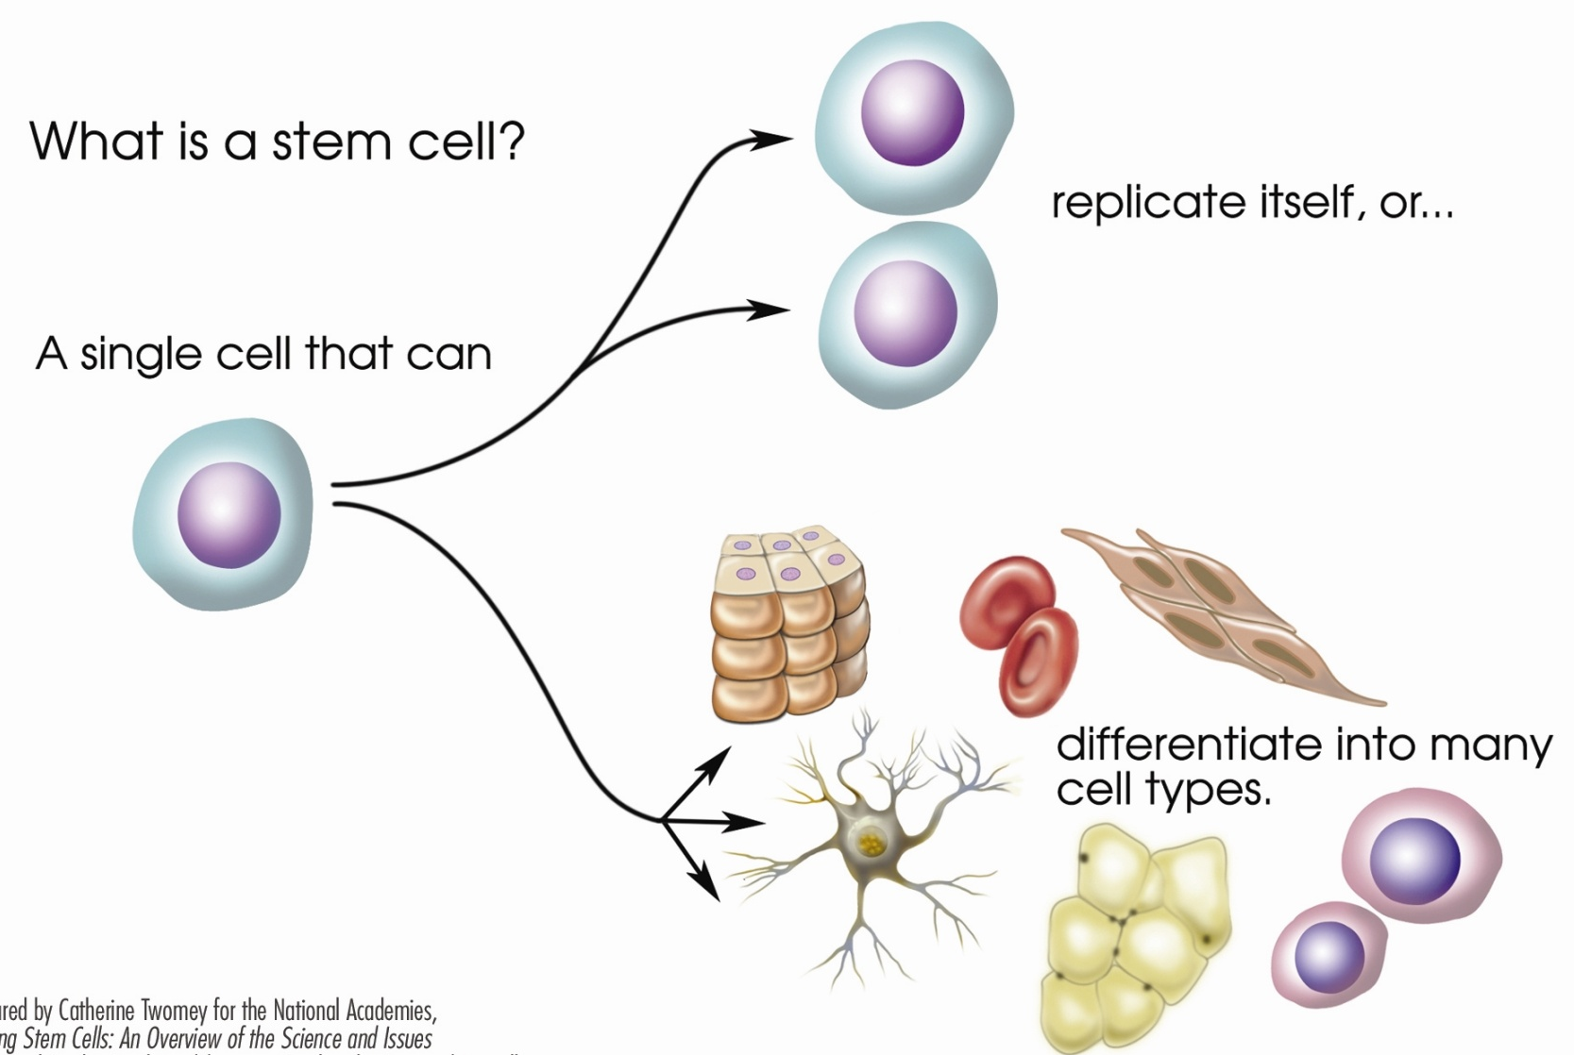
Cell Differentiation
The ball of cells that you started off as is called a zygote.
The cells of the zygote are called stem cells. Stem cells have the ability to specialize into any kind of cell.

Slide 24
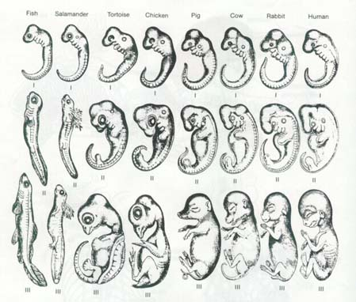
Cell Differentiation
After a week or two, the stem cells of the zygote start to differentiate, or take on specific functions. The zygote is now called an embryo.

Slide 25
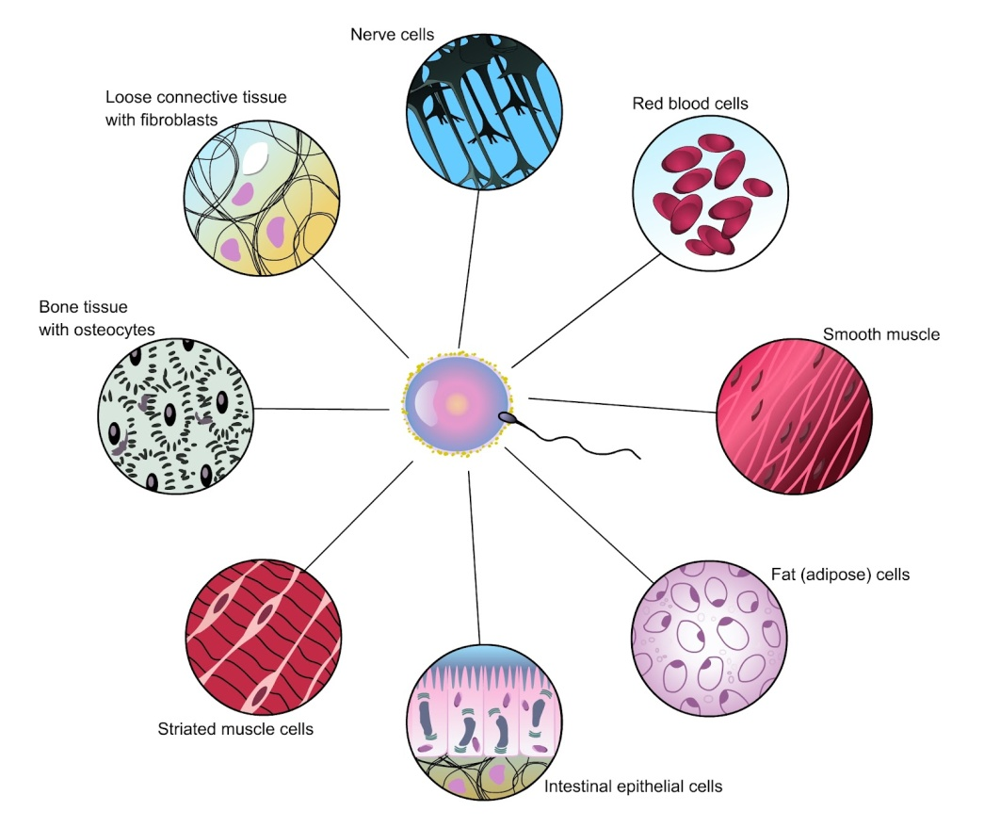
Cell Differentiation
Cell Differentiation is the process directed by the DNA code for converting stems cells into more specialized cells in multicellular organisms.
A cell is specialized because of the specific proteins it produces that allow the cell to carry out specific functions.

Slide 26
Cell Differentiation
Role of DNA
DNA holds the code that determines which genes will be expressed to make a cell specialized
Role of RNA
RNA carries the code from DNA to ribosomes, and helps assemble the proteins that will make the cells become specialized
Role of the Environment
Radiation, toxic chemicals, temperature, nutrition, and other factors can alter DNA causing changes in cell differentiation

Slide 27
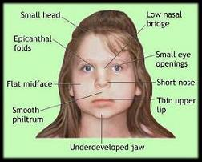
Cell Differentiation
Fetal Alcohol Syndrome is a condition that results from exposure to alcohol while in the womb. Not all exposure to alcohol will cause FAS, but symptoms can include physical and mental abnormalities.

Slide 28
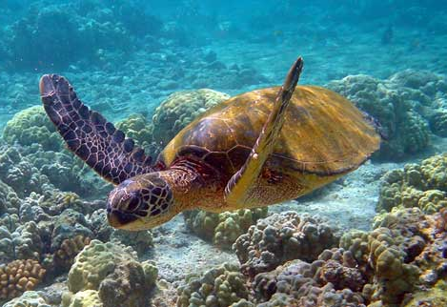
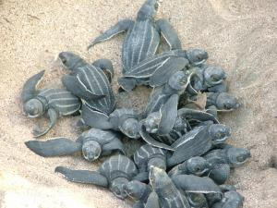
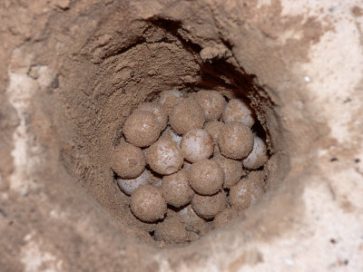
Cell Differentiation
In sea turtles, gender is determined by the temperature of the sand during the third trimester of their development. Warmer sand tends to produce female turtles while cooler sand produces male turtles.

