Slide 1
Biomolecule Structures!
GOOD LUCK!

Slide 2
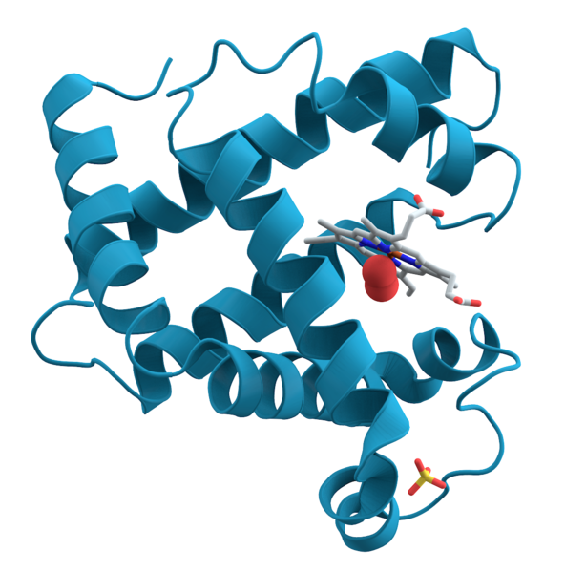
Protein

Slide 3
Carbohydrate (Glucose)

Slide 4
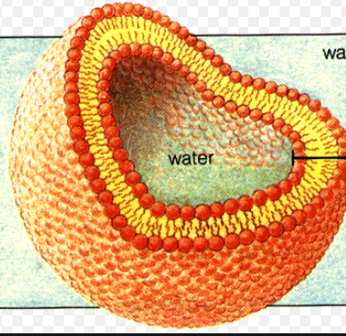
Lipid (Phospholipids in a cell membrane)

Slide 5
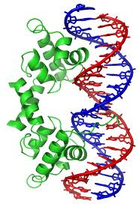
Protein & DNA!

Slide 6
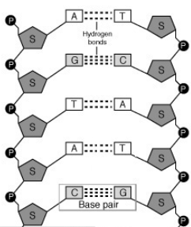
Nucleic Acid (DNA)

Slide 7
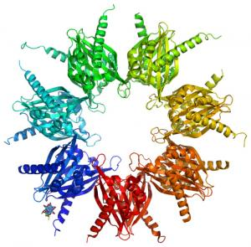
Protein

Slide 8
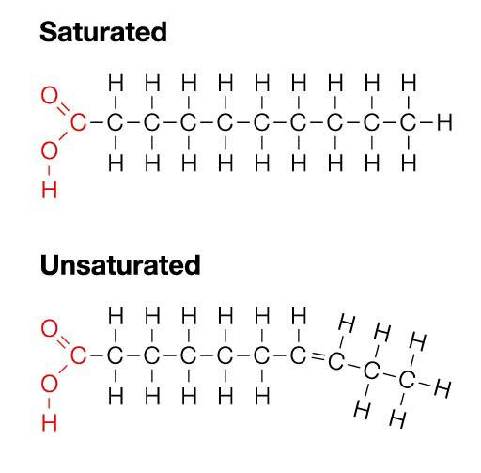
Lipid

Slide 9
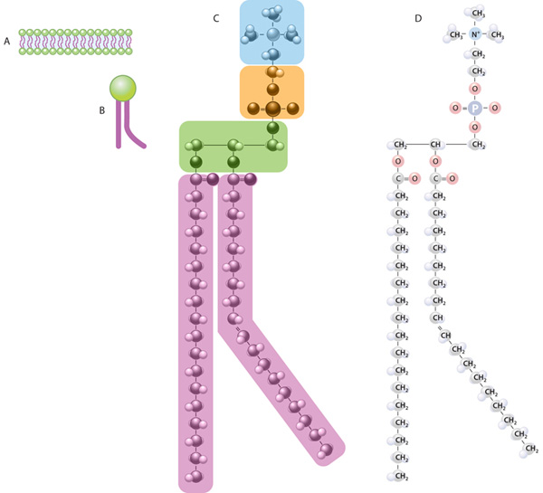
Lipid

Slide 10
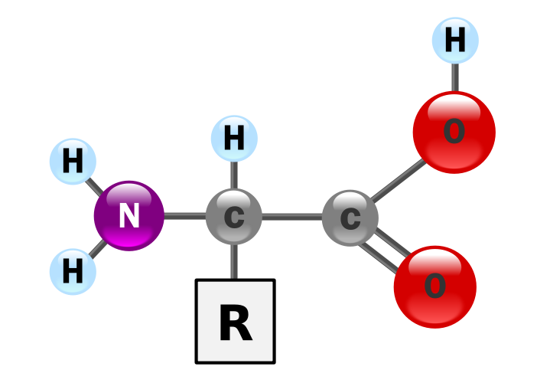
Protein

Slide 11
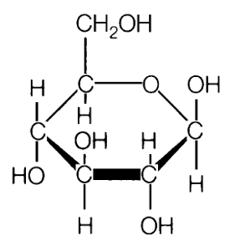
Carbohydrate

Slide 12
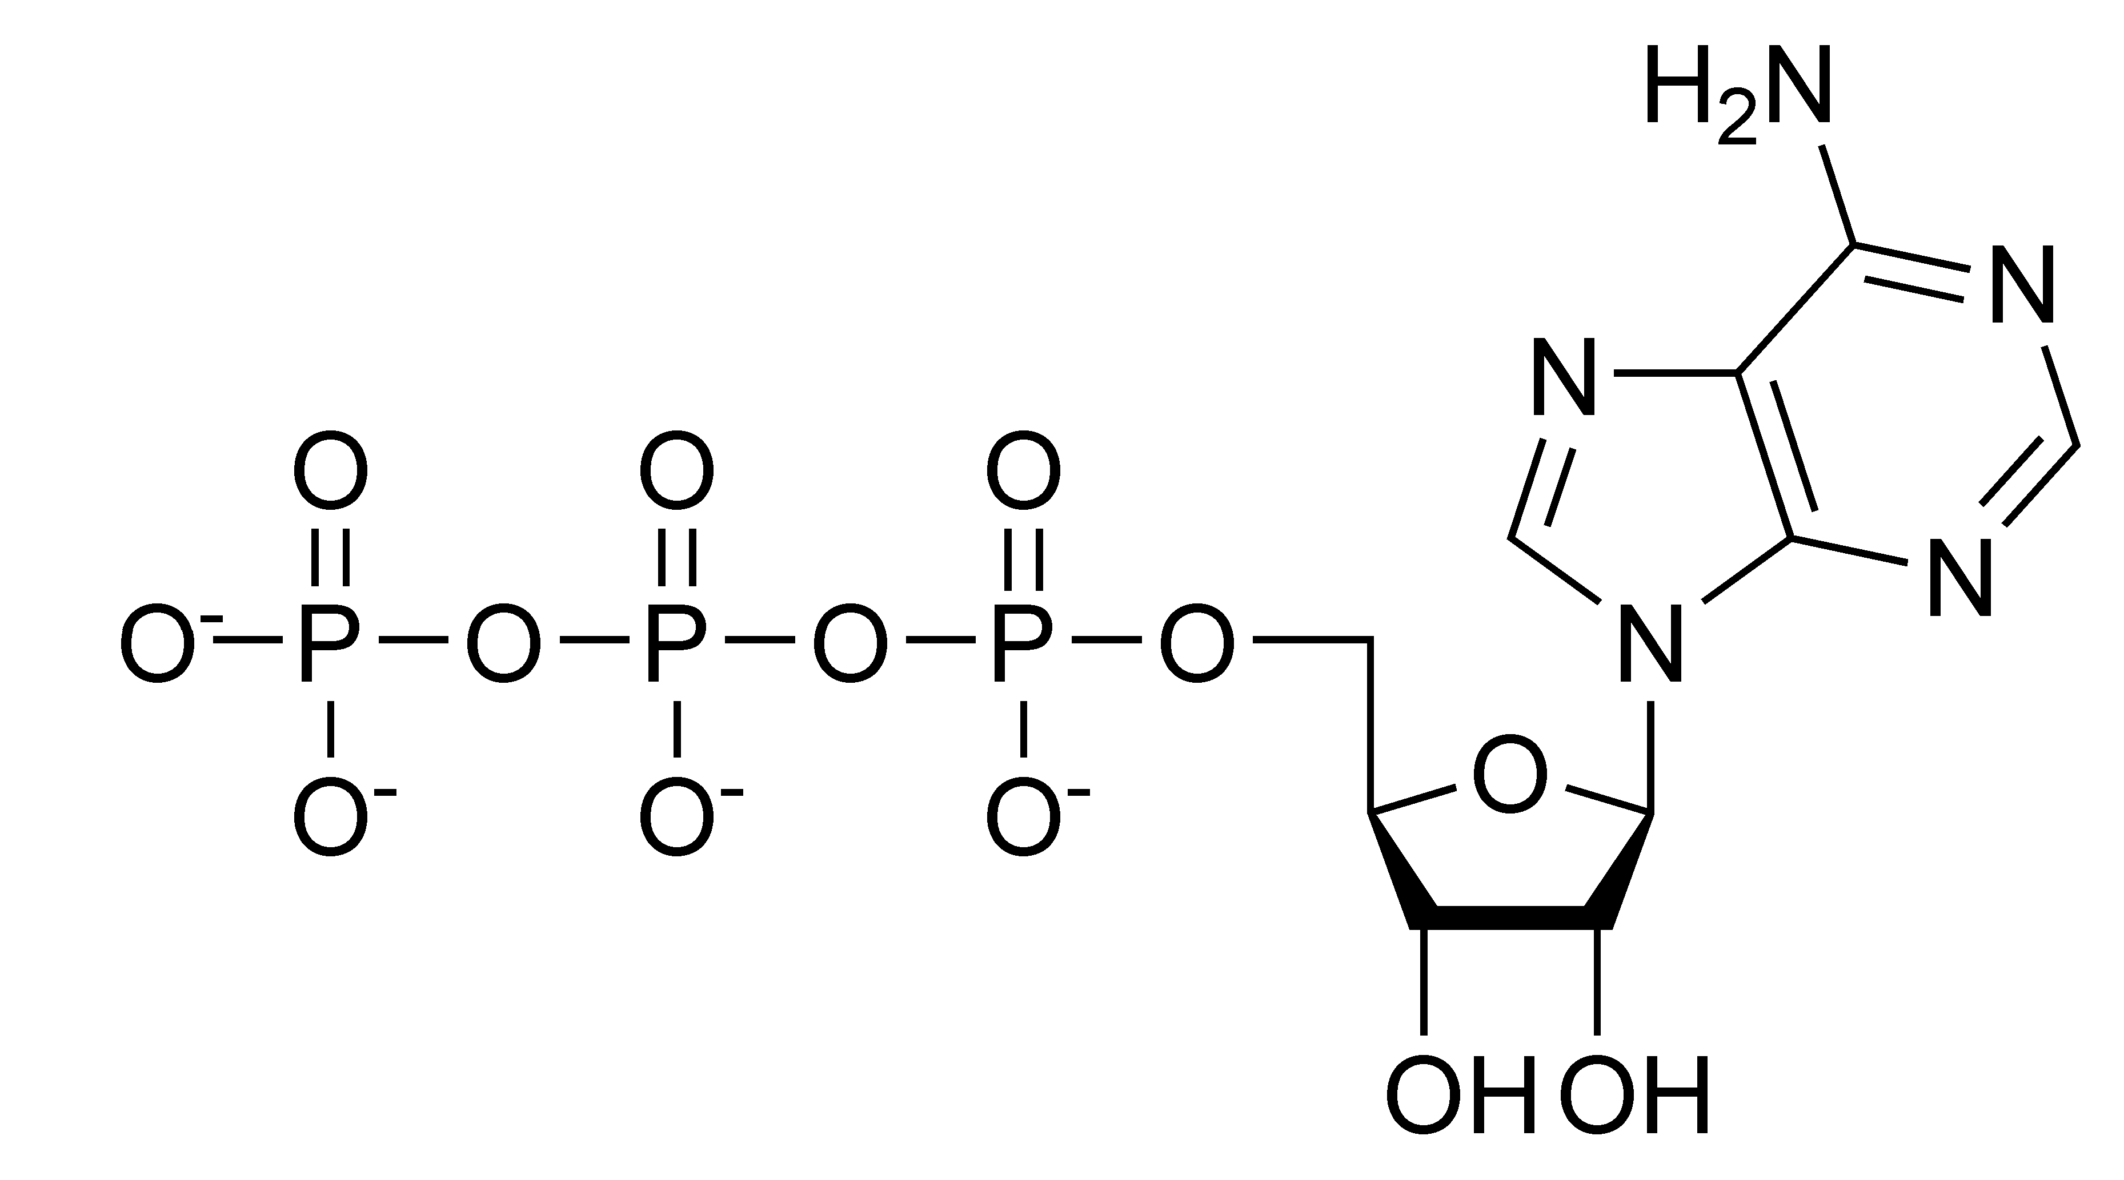
Nucleic Acid (ATP)

Slide 13
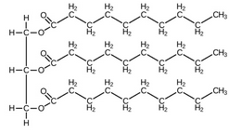
Lipid (Tryglyceride)

Slide 14
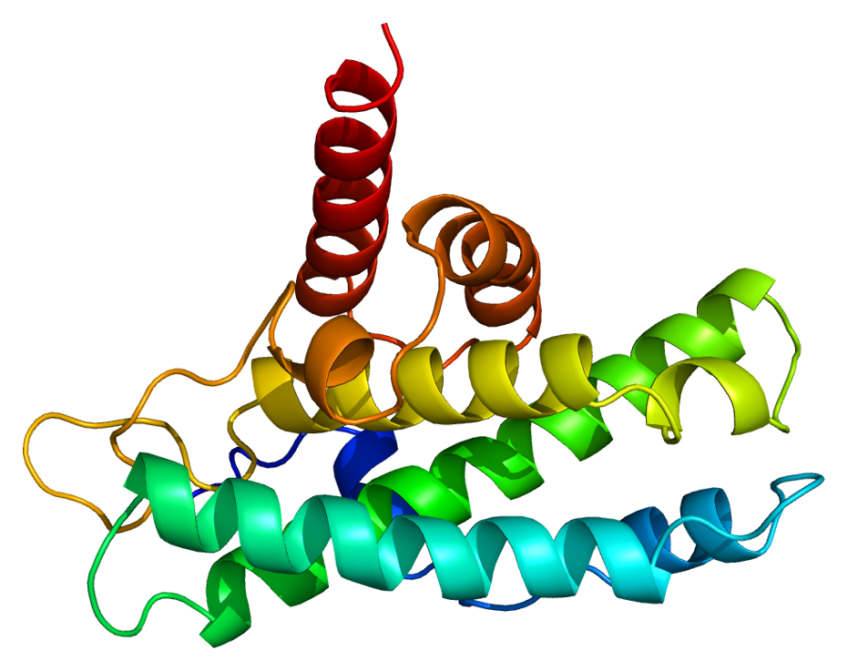
Protein

Slide 15
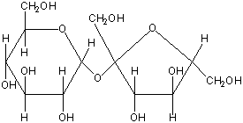
Carbohydrate

Slide 16
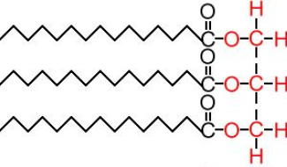
Lipid (Tryglyceride)

Slide 17
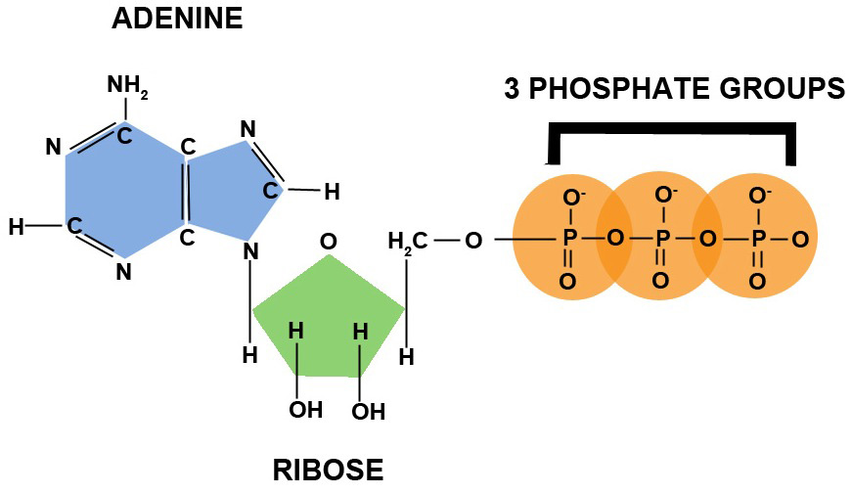
Nucleic Acid (ATP)

Slide 18
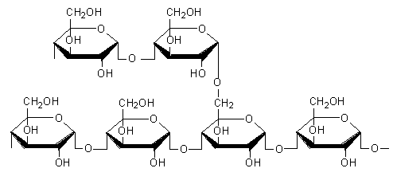
Carbohydrate

Slide 19
Protein

Slide 20
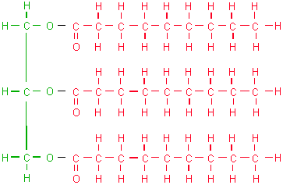
Lipid

Slide 21
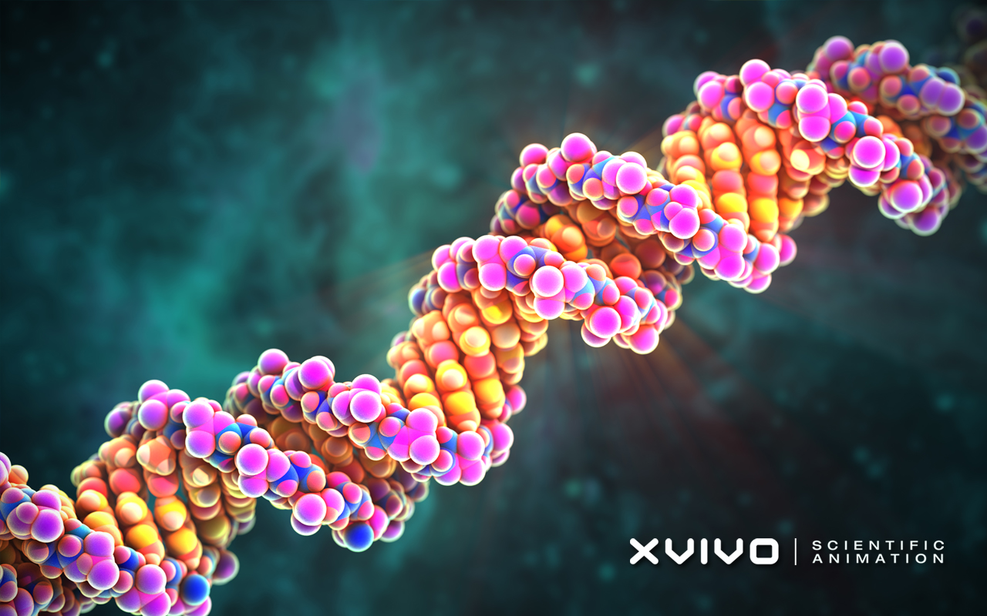
Nucleic Acid (DNA)

Slide 22
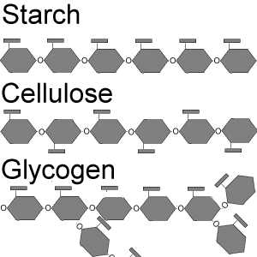
Carbohydrate

Slide 23
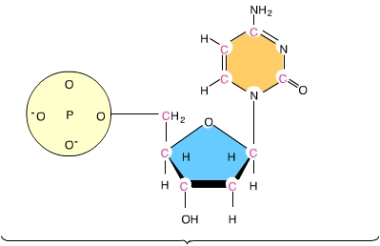
Nucleic Acid (DNA nucleotide)

