Slide 1
Biogeography

Slide 2
Wallace’s Realms (Pg 137-138)
Alfred Russell Wallace
These are now referred to as Biotic Provinces or Ecozones
In each province, major families of plant and animal life fill niches, with different major families in each province
Ex: bison and pronghorn antelope in North America fill the same niches as the capybara in South America, giraffes and antelopes in Africa, and kangaroos in Australia
Bounded by barriers that prevent mass immigration/emigration

Slide 3
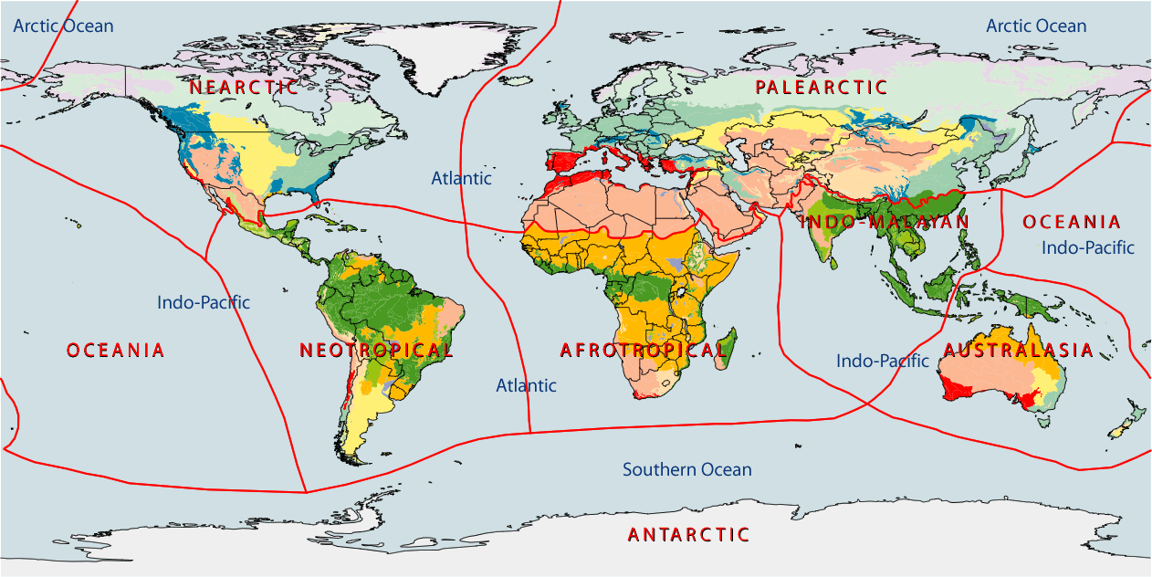
According to WWF

Slide 4
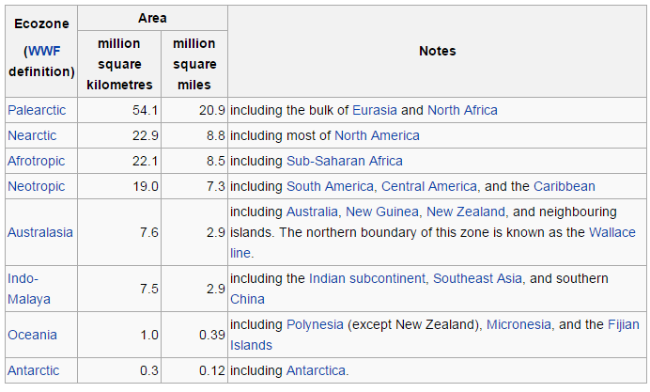
Ecozones

Slide 5
Island (Insular) Biogeography
Robert H. MacArthur and E.O. Wilson
Initial populations begin by migration and then undergo adaptive radiation (speciation to fill multiple new niches)
Islands have fewer species than continents
The smaller the island, the fewer the species
The farther an island is from the mainland, the fewer the species

Slide 6
Island Biogeography
# of species determined by immigration and extinction
Both of these rates change with distance
Closer islands less likely to experience extinctions due to “rescue effect,” where new immigrants from mainland save population
Influenced by: degree of isolation and length, size of island, habitat suitability, location relative to nutrient-rich ocean currents, chance, human activity
Similar things occur with habitat fragments, which lead to habitat corridors

