Slide 1
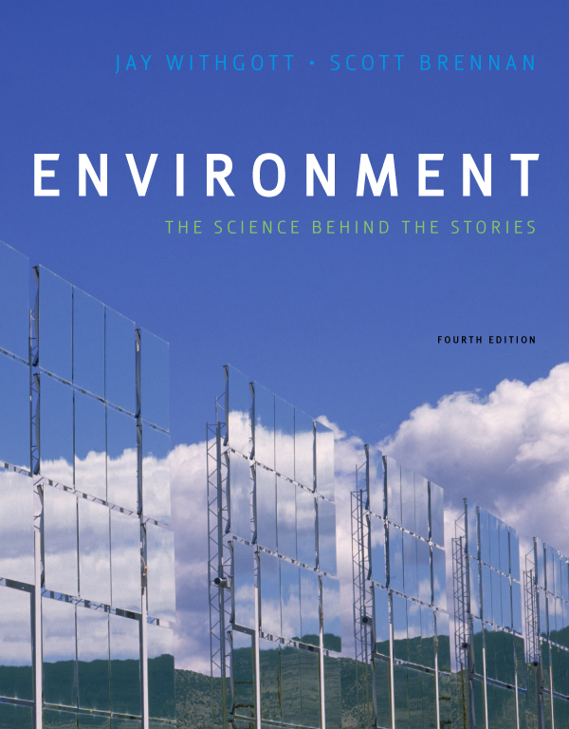
AP Environmental Science
Mr. Grant
Lesson 38
Biodiversity Loss and Species Extinction

Slide 2
Objectives:
Define the terms extinction, extirpation and mass extinction.
Contrast background extinction rates and periods of mass extinction.
Evaluate the primary causes of biodiversity loss.

Slide 3
Define the terms extinction, extirpation and mass extinction.
Extinction: The disappearance of an entire species from the face of the Earth.
Extirpation: The disappearance of a particular population from a given area, but not the entire species globally. (Locally extinct)
Mass Extinction: The extinction of a large portion of the world’s species in a very short time period due to some extreme and rapid change or catastrophic event. The Earth has seen five mass extinction events in the past half-billon years.

Slide 4
Contrast background extinction rates with periods of mass extinction.
Species have gone extinct at a background rate of roughly one species per 1 to 10 million species each year. Most species that have ever lived are now extinct.
Earth has experienced five mass extinction events in the past 440 million years.
Human impact is presently initiating a sixth mass extinction.

Slide 5
Biodiversity loss and species extinction
Extinction = occurs when the last member of a species dies and the species ceases to exist
Extirpation = the disappearance of a population from a given area, but not the entire species globally
Can lead to extinction
Extinction can be a natural process
99% of all species that ever lived are now extinct
Background rate of extinction = natural extinctions
For mammal or marine species: each year 1 species out of every 1–10 million goes extinct

Slide 6
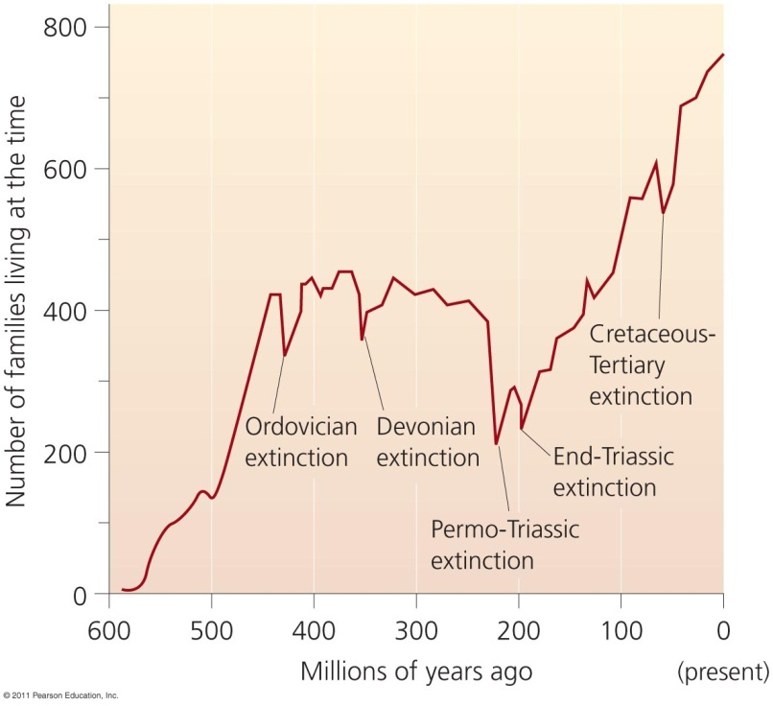
Earth has had five mass extinctions
Earth has had five mass extinctions in the past 440 million years
Each event eliminated at least 50% of all species
Humans are causing this sixth extinction event
What consequences could our species experience?

Slide 7
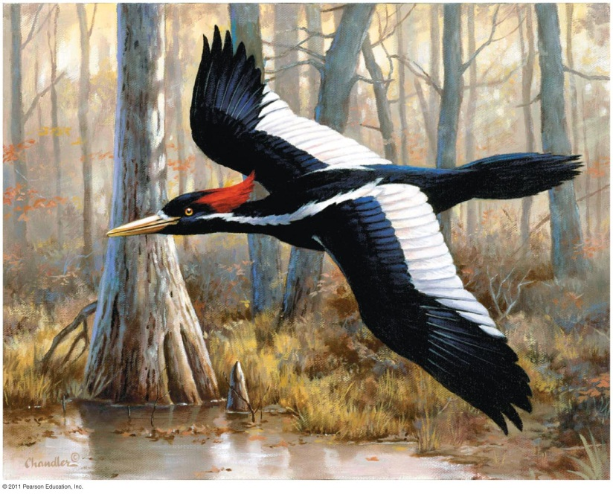
Humans are causing this mass extinction
Humans have driven hundreds of species to extinction
Dodo bird, Carolina parakeet, passenger pigeon
Multitudes of others teeter on the brink of extinction
Whooping crane, Kirtland’s warbler, California condor
The ivory-billed woodpecker may not be extinct

Slide 8
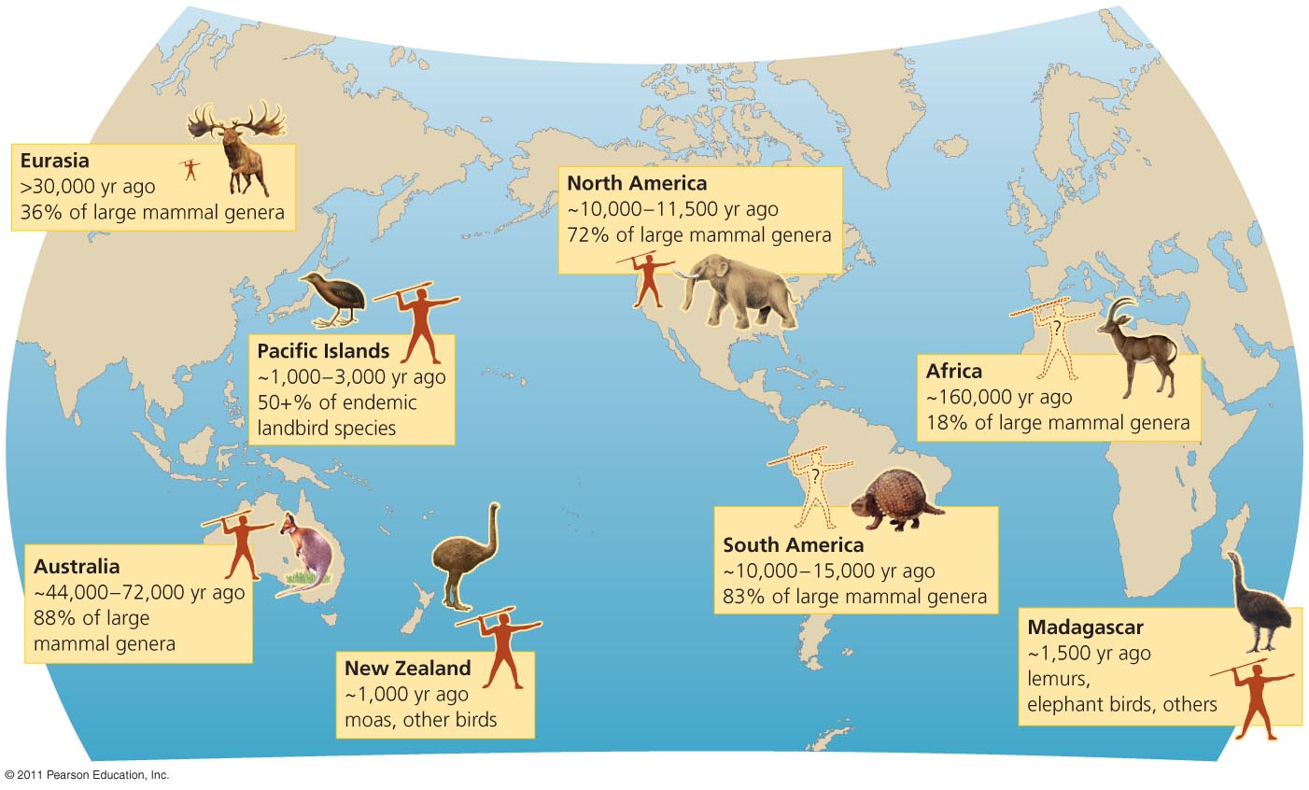
People have hunted species to extinction
Extinctions followed human arrival on islands and continents

Slide 9
Current extinction rates are higher than normal
The current extinction rate is 100 to 1,000 times greater than the background rate
This rate will increase tenfold in future decades
Human population growth and resource consumption
The Red List = species facing high risks of extinction
Mammal species (21%), bird species (12%)
17–74% of all other species
http://www.iucnredlist.org/ (Int’l Union for Conservation of Nature)
In the U.S., in the last 500 years, 237 animal and 30 plant species have been confirmed extinct
Actual numbers are undoubtedly higher

Slide 10
HIPPCO: A mnemonic for remembering how biodiversity is lost
Habitat Loss
Illegal Killing/Invasives
Population and Resources (competition)
Pollution/Pesticides
Climate Change
Overexploitation

Slide 11
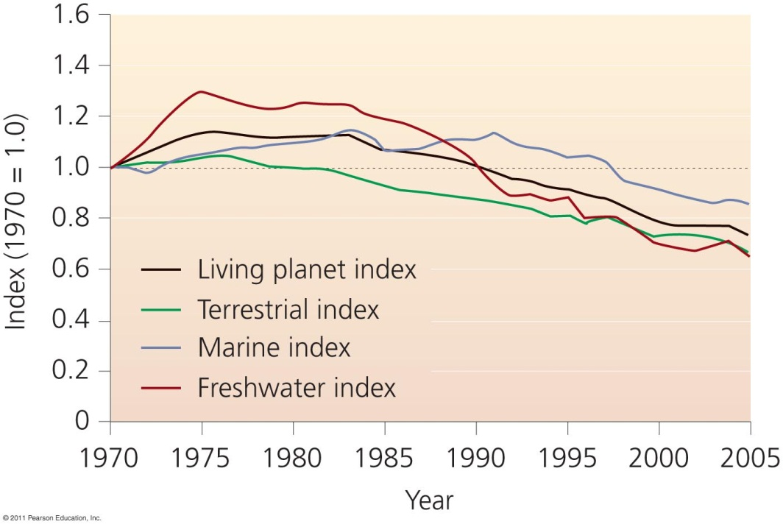
Biodiversity loss is more than extinction
Genetic, ecosystem, and species diversity is being lost
The Living Planet Index summarizes population trends like a stock market
Between 1970 and 2005, the index fell by 28%

Slide 12
Biodiversity loss has many causes
Reasons for biodiversity losses are complex and hard to determine
Multiple factors interact in causing losses
Four primary causes of population decline are:
Habitat alteration
Invasive species
Pollution
Overharvesting
Global climate change now is the fifth cause

Slide 13
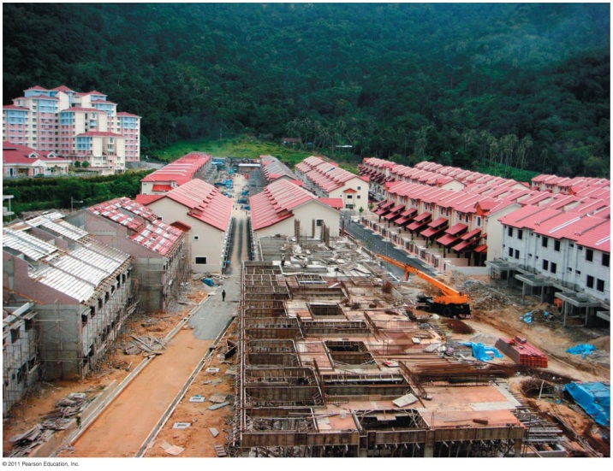
Habitat alteration causes biodiversity loss
The greatest cause of biodiversity loss
Habitats are destroyed, fragmented, and degraded
Farming simplifies communities
Grazing modifies grassland structure and composition
Clearing forests removes resources organisms need
Hydroelectric dams turn rivers into reservoirs
Suburban sprawl replaces natural communities
A few species (e.g., pigeons, rats) benefit from changing habitats

Slide 14
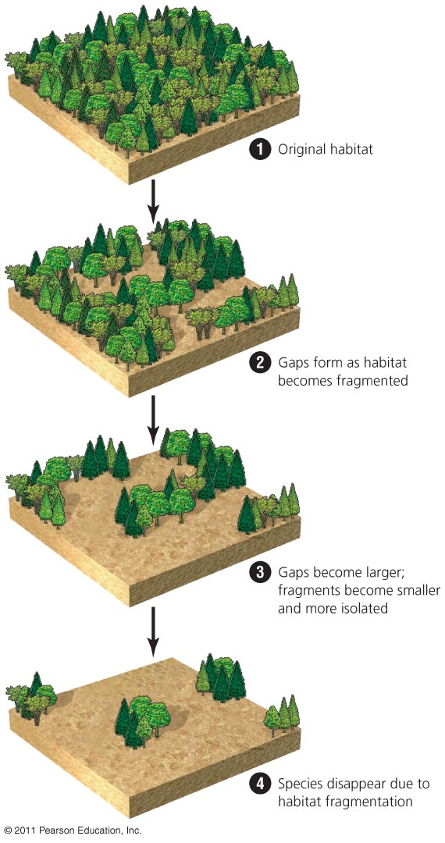
Habitat fragmentation
Habitat fragmentation = gradual, piecemeal degradation of habitat
Farming, roads, logging, etc.
Continuous habitats are broken into patches
Species needing that habitat disappear
Landscape-level strategies try to optimize areas to be preserved

Slide 15
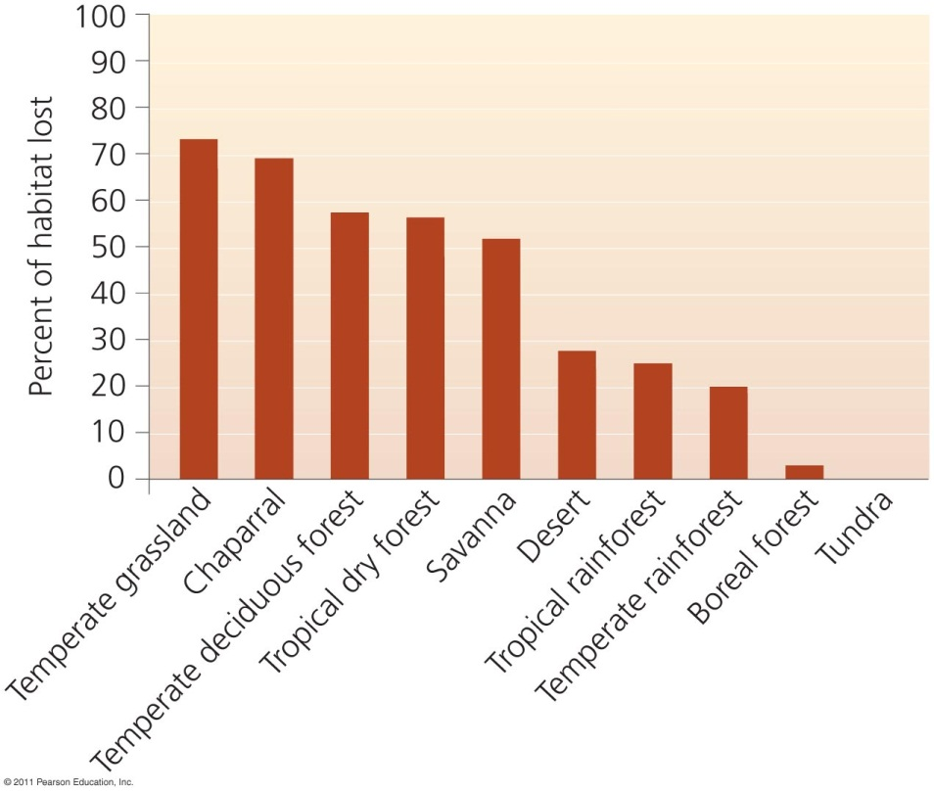
Habitat loss occurs in every biome
Habitat loss is responsible for declines for 83% of mammals and 85% of birds
99% of U.S. prairies have been converted to agriculture
Grassland birds have declined 82–99%

Slide 16
Pollution causes biodiversity loss
Pollution harms organisms in many ways
Air pollution degrades forest ecosystems
Water pollution impairs fish and amphibians
Agricultural runoff harms terrestrial and aquatic species
Toxins, garbage, oil, and chemicals impact organisms
Damage to wildlife and ecosystems caused by pollution can be severe
But it is less than the damage caused by habitat alteration or invasive species

Slide 17
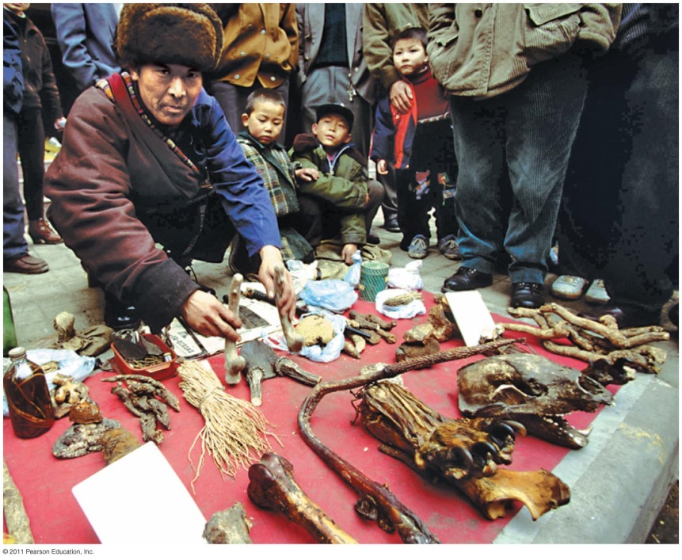
Overharvesting causes biodiversity loss
Vulnerable species: K-selected , habitat specialists
Large, few in number, long-lived, and have few young
The Siberian tiger is hunted without rules and regulations
Powerful economic incentives increase poaching
Many other species are affected
Whales, sharks, gorillas
The oceans contain only 10% of the large animals they once did

Slide 18
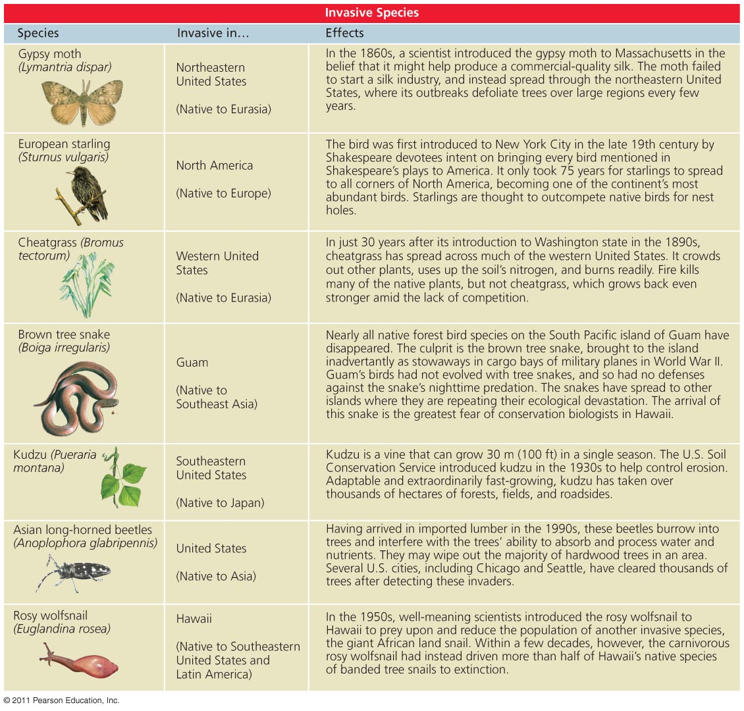
Invasive species cause biodiversity loss
Introduction of non-native species to new areas
Accidental: zebra mussels, weeds
Intentional: food crops, exotic pets, ornamental plants
Island species are especially vulnerable
Invaders lack natural predators, competitors, or parasites
Invaders cost billions of dollars in damage each year

Slide 19
Climate change causes biodiversity loss
Human manipulation of Earth’s climate system has global impacts on biodiversity
Emission of greenhouse gases warms temperatures
Modifying global weather patterns
The frequency of extreme weather events increases
Droughts, etc.
Increased stress forces organisms to shift their geographic ranges
Most animals and plants will not be able to adapt
20–30% of species are at increased risk of extinction

Slide 20
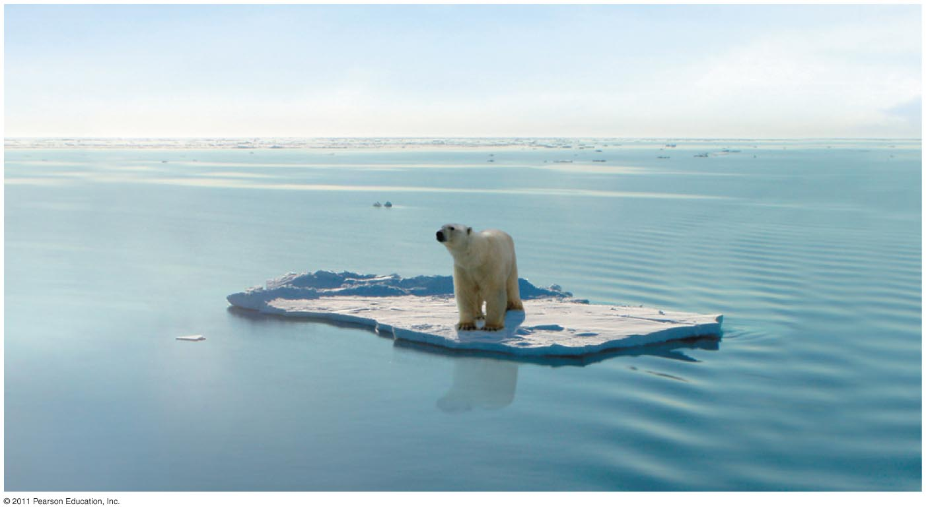
Warming has been the greatest in the Arctic
Because of melting ice, polar bears can’t hunt seals, so they were added to the endangered species list in 2008

Slide 21
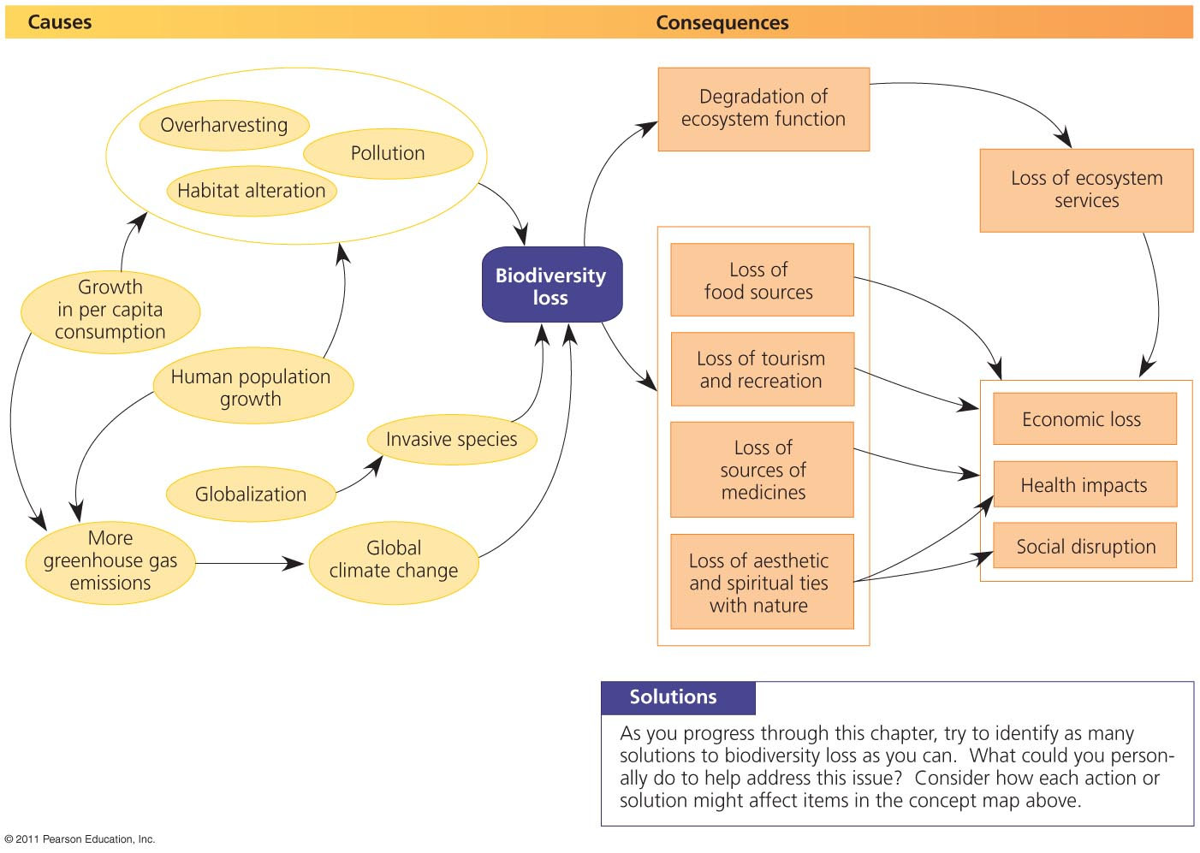
Causes and consequences of biodiversity loss

Slide 22
CITES
The Convention on International Trade in Endangered Species of Wild Fauna and Flora (CITES) is an international treaty to prevent species from becoming endangered or extinct because of international trade.
Under this treaty, countries work together to regulate the international trade of animal and plant species and ensure that this trade is not detrimental to the survival of wild populations. Any trade in protected plant and animal species should be sustainable, based on sound biological understanding and principles.
Created in 1973 & implemented by 180 countries

Slide 23
Endangered Species Act: Protecting imperiled species
Administered by the U.S. Fish and Wildlife Service and the Commerce Department’s National Marine Fisheries Service (NMFS).
The FWS has primary responsibility for terrestrial and freshwater organisms, while the responsibilities of NMFS are mainly marine wildlife such as whales and anadromous fish such as salmon.
Under the ESA, species may be listed as either endangered or threatened. “Endangered” means a species is in danger of extinction throughout all or a significant portion of its range. “Threatened” means a species is likely to become endangered within the foreseeable future.

